Slide 1

AIR
Autonomous Interdependent Repositories
by Artem Shamsutdinov

Slide 2
Federated Multi-Repository Database
Any # of users, web sites/Apps.
Any # of schemas for any # publishers
Data access w/o network connection
Access to only allowed data
Data confidentiality and authenticity
Redundant storage and archival
Switchable sharing channels
“eventually consistent”
“time traveling”

Slide 3
Data Sharing
Multiple web sites and mobile/desktop apps on same device
Any device - IOT to central database
Back up in cloud or network storage
No central processing server

Slide 4
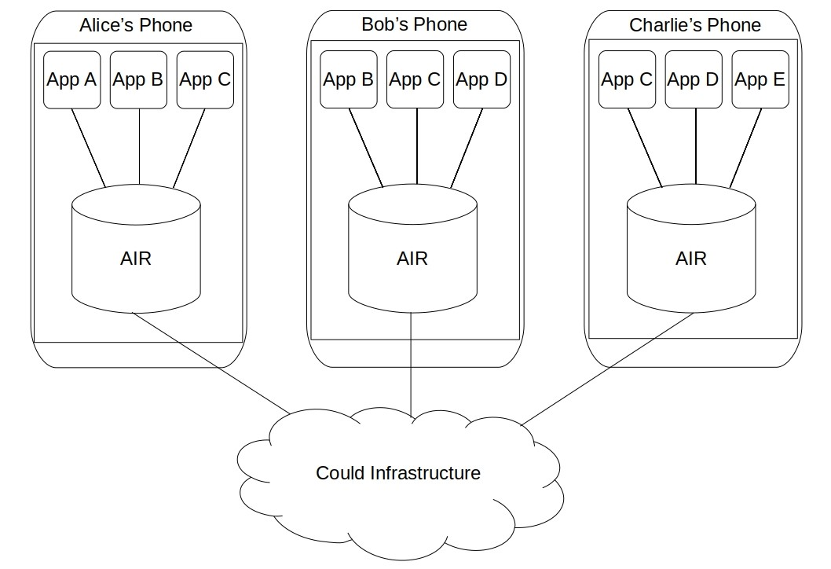

Slide 5
Repositories
Building blocks
Virtual collections of related records
Database only has Repositories of its user
All data users need and none they don’t
User can remove any repository from a device

Slide 6
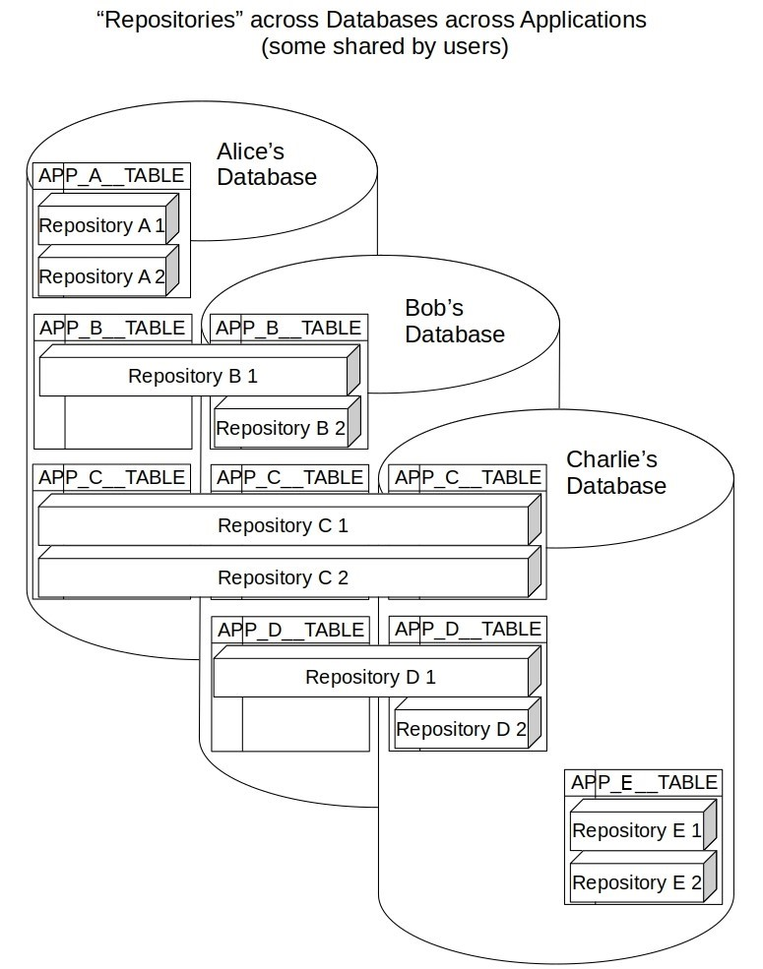

Slide 7
Granularity
Repository is a time bound unit of knowledge
Only has users with “need to know”
Better sharing/synchronization performance
Easier archiving

Slide 8
Grouping
Grouped by labels and hierarchies
Those are stored in Metadata Repositories
Metadata Repository stores information about other Repositories
Repository has own (internal) metadata

Slide 9
Uses
Secure data sharing
Off-line
Best for multiple Applications
Inspection of the order of operations
Time traveling
Redundancy and data authenticity
Data inconsistency tolerance
Different data compositions
Conflict detection & resolution

Slide 10
User-centric Data
Data belongs to users, not apps
Store only data needed
All data backed up in cloud

Slide 11
Synergy across Apps
Multiple websites and mobile Applications access the same data
Schemas open to other Applications
Other Apps enrich functionality of original Application in new ways
User gains more value from already entered data
Publisher monitors what Applications are using their schema
Compound benefit of data accumulated across many Apps
New AIR Application immediately gain access existing data

Slide 12
Fine Grained Access Control
User is in charge of data access
To which application allow access of which data
Applications can still proactively ask permission

Slide 13
Value in Interdependence
More meaningful data across repositories
Repositories should be interdependent
Permanent records referenced across repositories
Deletable record cannot be referenced

Slide 14
Privacy by Design
Strong privacy guarantees
Reduces Application liability

Slide 15
Technical Summary
Traditional database engine + additional logic:
Communicating with client Apps
Communicating with other AIR dbs
Maintaining internal state
Multiple communication mechanisms

Slide 16
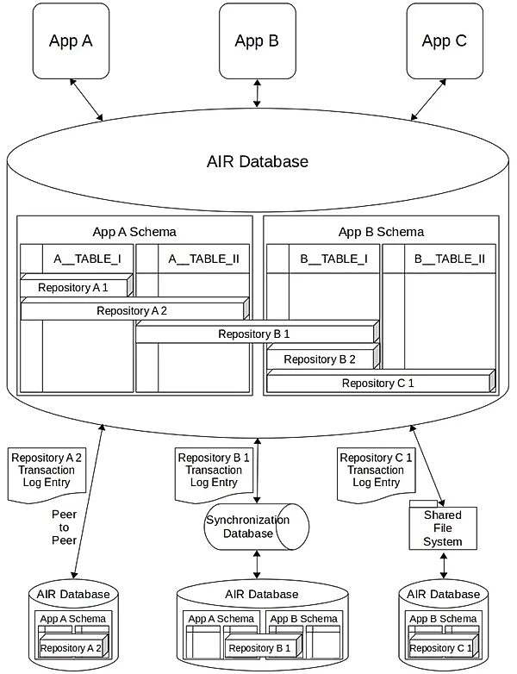

Slide 17
Repositories
AIR Database is a fully functional relational database
Repository is a collection of rows across any number of tables
AIR Database stores any number of repositories
Repositories are archived away and are retrieved back
Referential integrity disabled to allow references to missing Repositories

Slide 18
Repository Identifiers
Identified by Repository Id, Actor Id and Actor Record Id
Actor = User + Device + Application
Ids cannot be updated

Slide 19
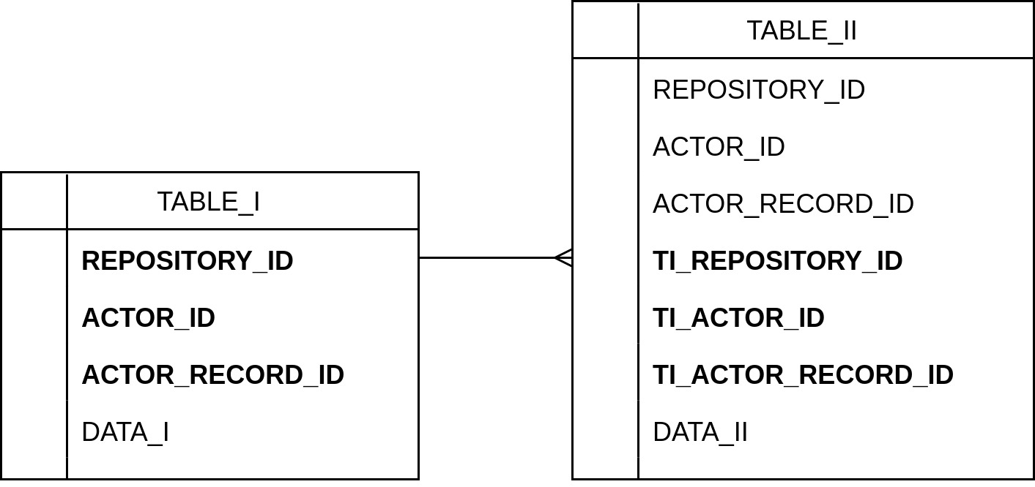

Slide 20
Transactions
Applications create database wide transactions
AIR splits into per-Repository transactions
One or more modifications in Repository transactions
Repository operations always by unique identifiers
AIR converts all modifications into “by Id” operations

Slide 21
Repository Sharing
Owner/permitted users invite others to repositories
Privileges are in internal repository
Read-only vs Read-Write

Slide 22
Transaction Log
Changes to Repository recorded in its Transaction Log
Ordered by time of synchronization
Shared across databases
Repository state may differ across Databases
State is “eventually consistent”
Repository archive = all Transaction Log entries, ordered
Archived Repository load = execution of all entries, in order

Slide 23
Local History
Transaction Log stored as Local History in database
Can be reconstructed from Local History
Vice versa
Local history is grouped by database transaction, repository transaction, operation, and modified entity

Slide 24
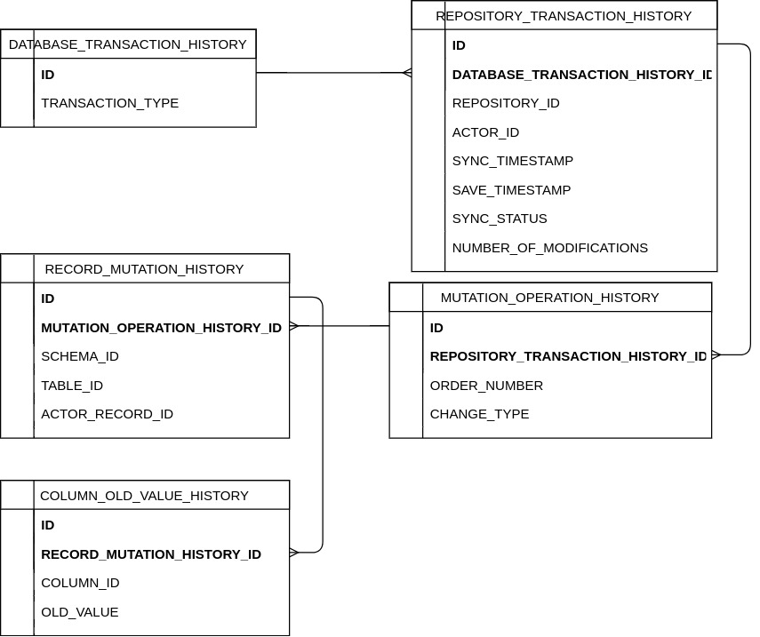

Slide 25
Security
Transaction Log entries are encrypted
Repository specific symmetric key
Key distributed between Actors via private public/private keys
Transaction Log entries are signed with Actor’s private key.

Slide 26
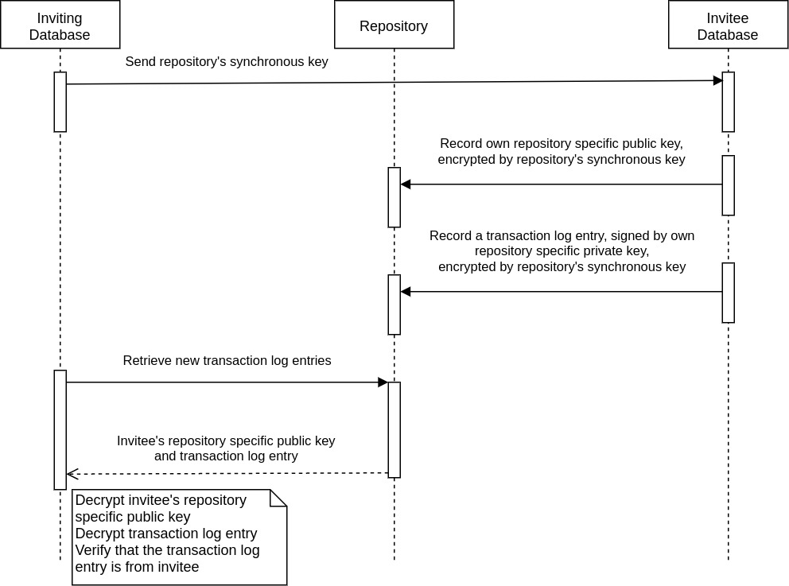

Slide 27
Schemas
Apps provide schemas
Schemas distributed directly or via publishing platform
Apps store records in own or other schemas
Apps may allow other Apps to do CRUD
Applications grand/revote access at any time
Grants to App, Table, Column or User / per Operation
Grant groupings possible
Dedicated grant repositories distributed by Apps

Slide 28
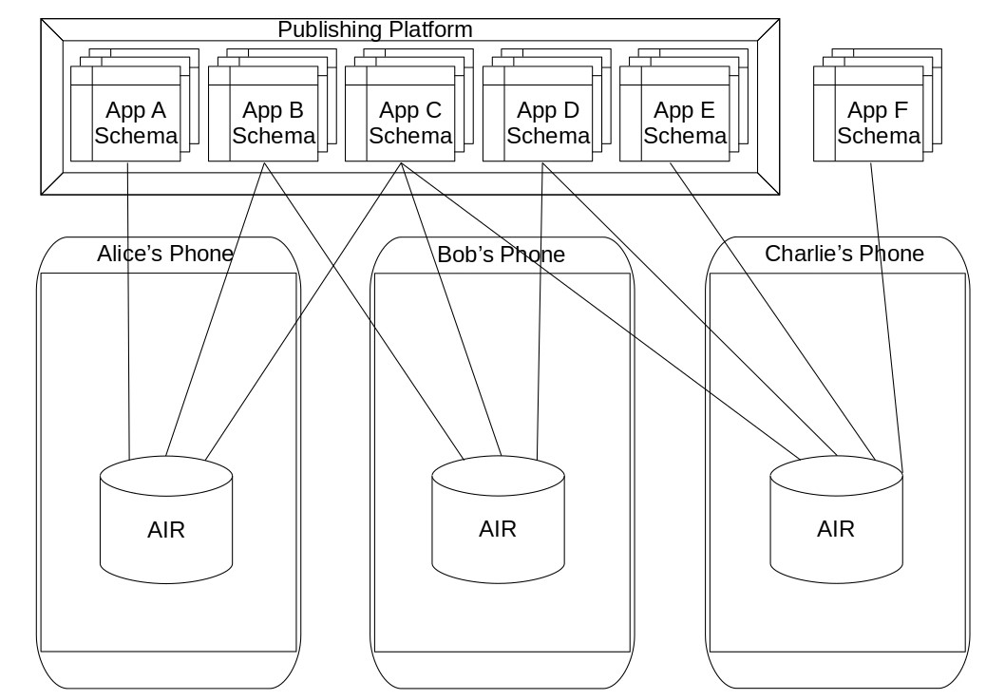

Slide 29
Upgrades
Schemas upgraded at any time
Require full backward compatibility for Read operations
App with older version of schema can always Read
Compatibility via database views
Schema publishers provide schema upgrade code
Also provide Transaction Log upgrade code

Slide 30
User access
Users grant Repository access/modification privileges to users and Apps
Grouping possible
Wildcards can be used
Can specify sharing settings in internal metadata of Repositories

Slide 31
Access Checks
All Read and Modification requests from Apps are checked
Is calling App registered and permitted to CRUD?
Is request format valid?
Can App use tables/columns in request?
Can App use Repositories in request?

Slide 32
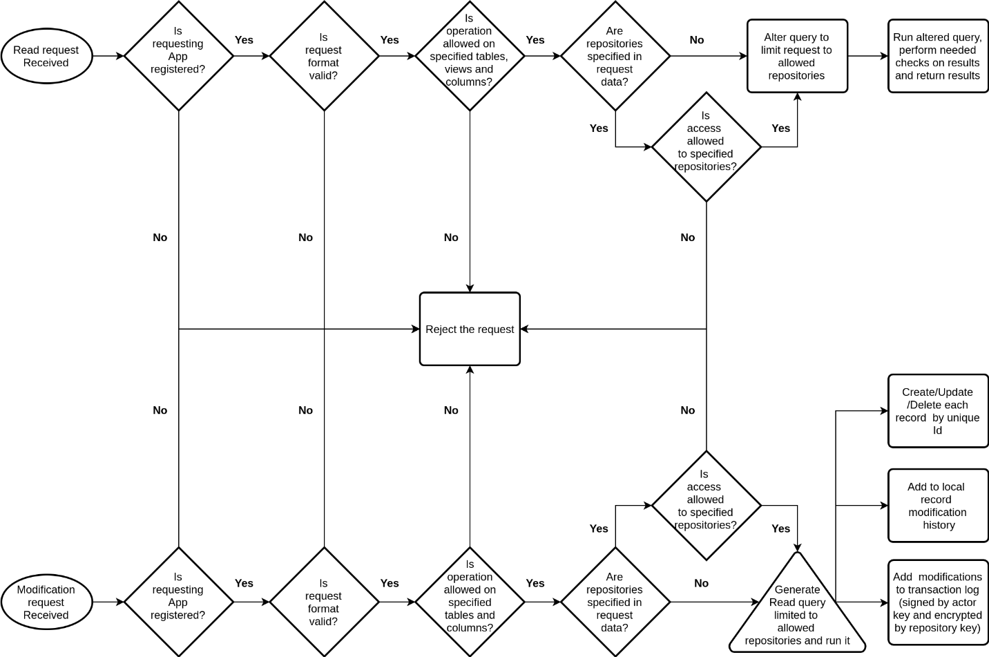

Slide 33
Read Access
After common checks:
Alter query - join with Repository reference tables via Actor Id
Limit Repositories to allowed for calling Actor
Can filter/alter Query results if needed

Slide 34
Modification Access
After common checks:
Generate Read query (with Read Access logic above)
Query returns C_UD records
Perform modification (by Id)
Record Local History

Slide 35
Synchronization
AIR database = Sharing Node
Sends Transaction Log entry messages to correct Sharing Nodes
Receives those messages
If peer-to-peer - route messages

Slide 36
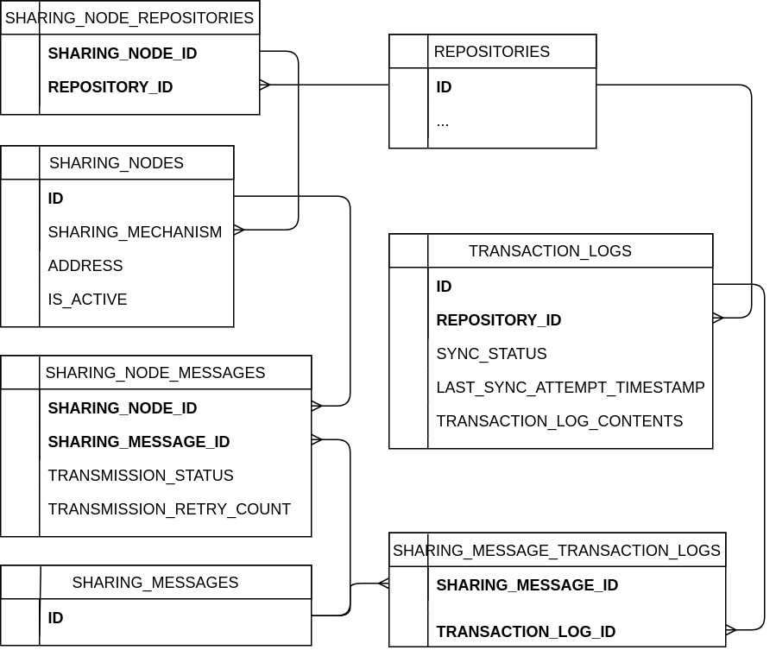

Slide 37
Synchronization Checks
Are local Transaction Logs not synced?
Send to which Sharing Nodes?
Group and send sharing messages
If synced mark as such
If not resend later

Slide 38
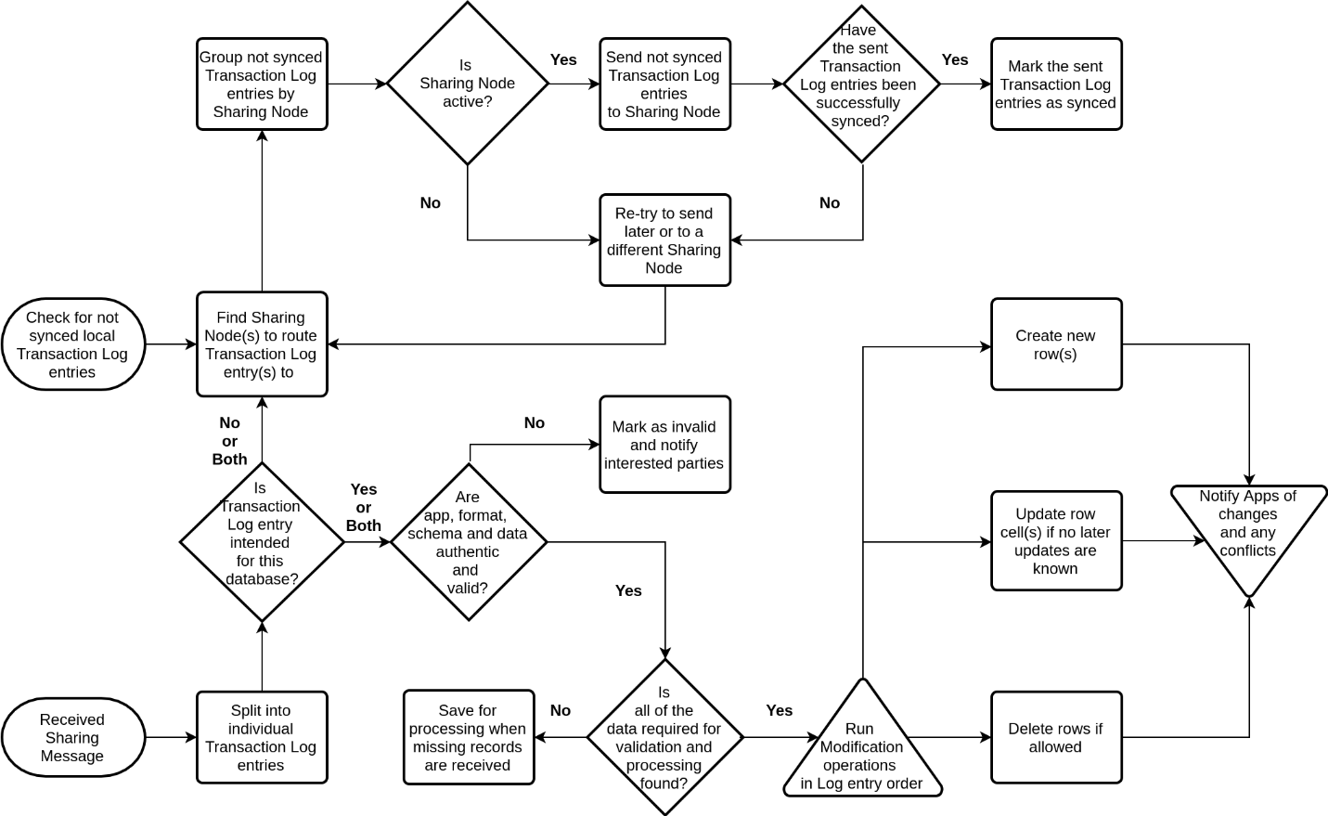

Slide 39
Receive Checks
Split into individual Transaction Log entries
Is entry for local database?
If No (or both) forward to other Sharing Nodes
If Yes decrypt, authenticate, and validate like local operation
If all need data found then run in order of operations
Values Updated if no subsequent Updates
Rows Deleted if no subsequent Updates
Notify Apps of changes/conflicts/resolutions

